Slide 1
Lattices and Boolean Algebra
by
Dr. T. M. Rajalaxmi
Assistant Professor
Department of Mathematics

Slide 2
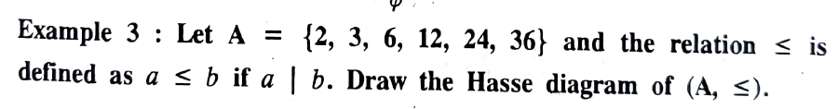
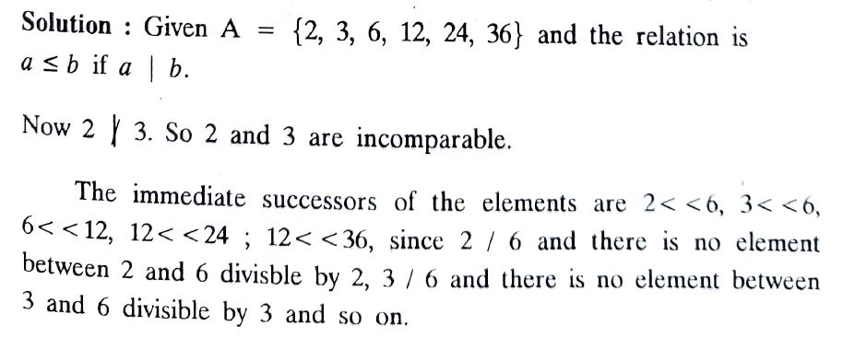
Hasse diagram examples
3.

Slide 3
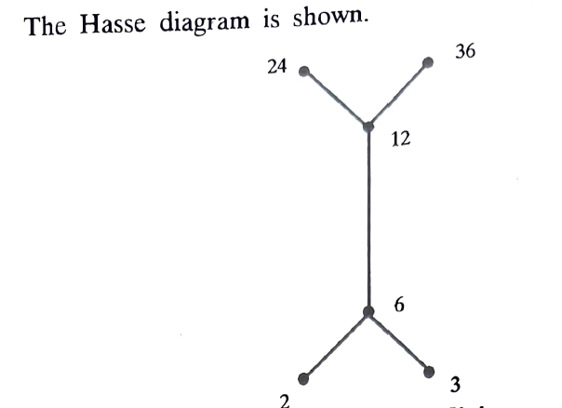
Hasse diagram examples

Slide 4
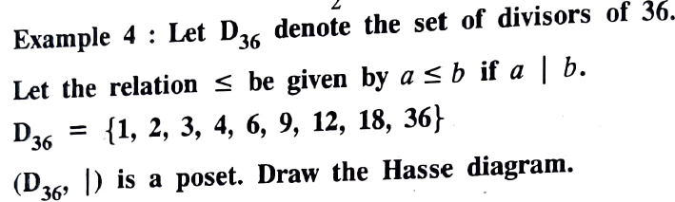
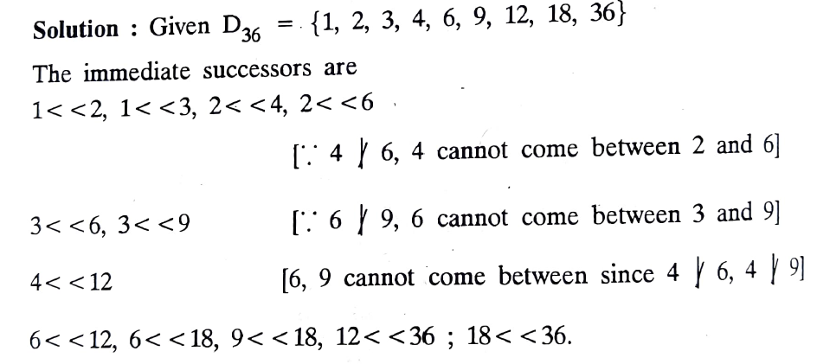
Hasse diagram examples

Slide 5
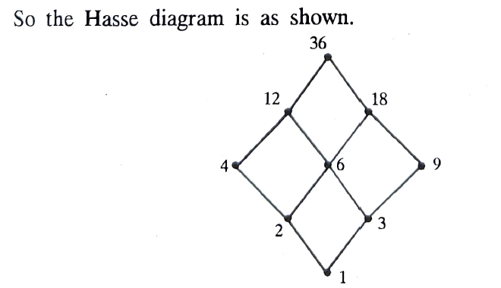
Hasse diagram examples

Slide 6
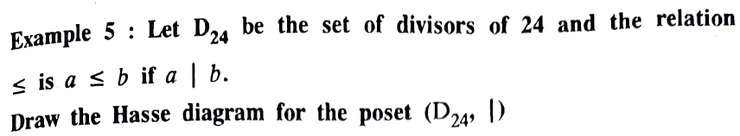
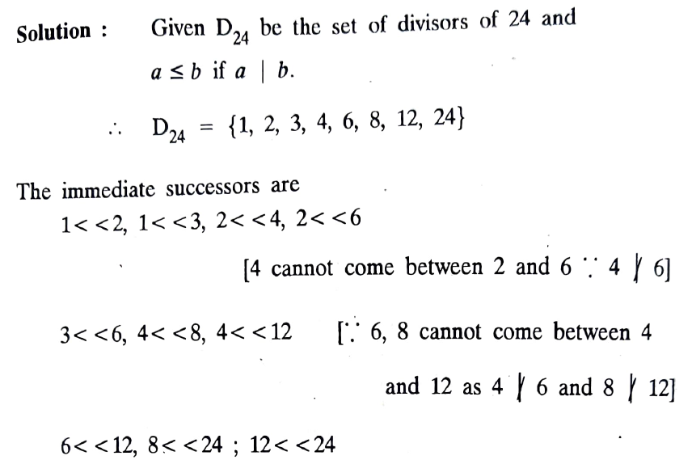
Hasse diagram examples

Slide 7
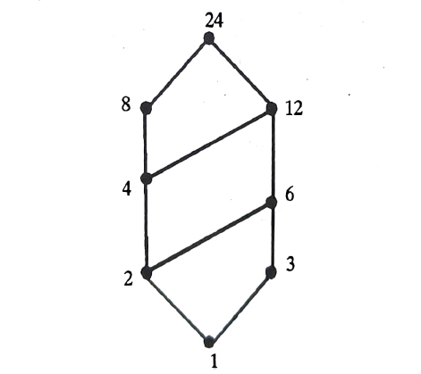
Hasse diagram examples

Slide 8
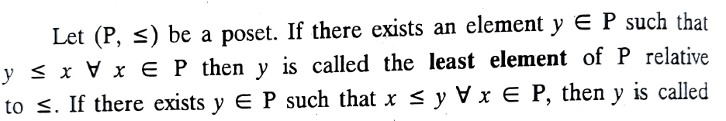
Least and Greatest element of poset
Definition

Slide 9
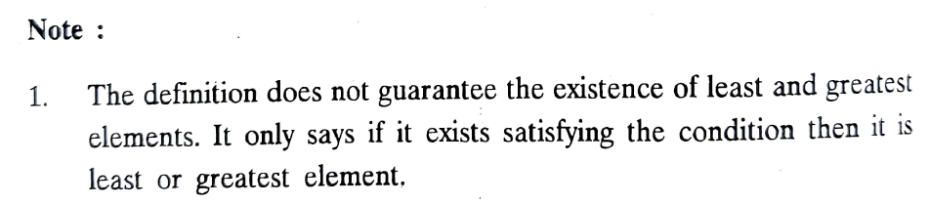
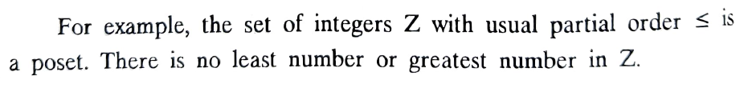
Least and Greatest element of poset

Slide 10
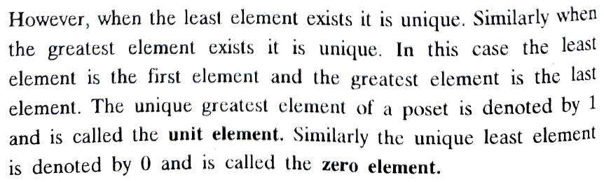
Least and Greatest element of poset
Note

Slide 11
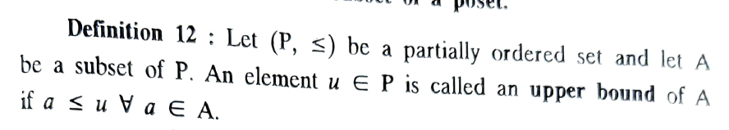

Upper and lower bounds of a subset of a poset
Definition

Slide 12
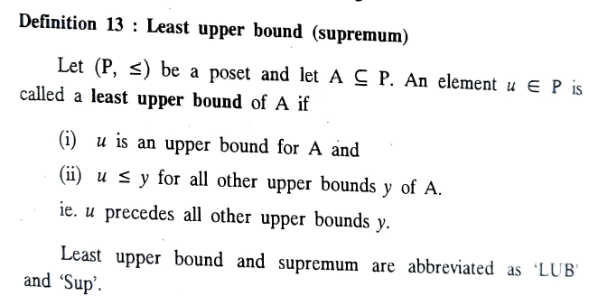
Least Upper Bound
Definition

Slide 13
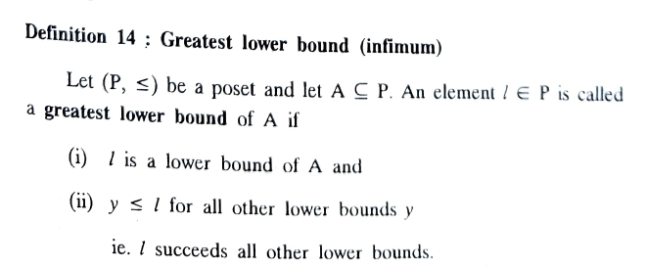
Greatest Lower Bound
Definition

Slide 14
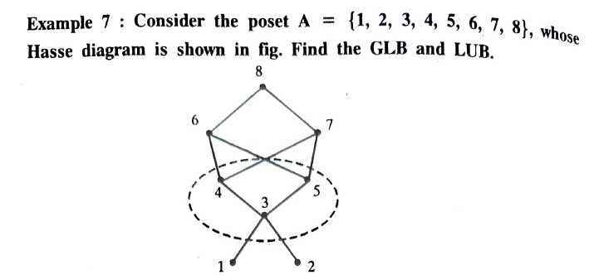
Problem 1

Slide 15
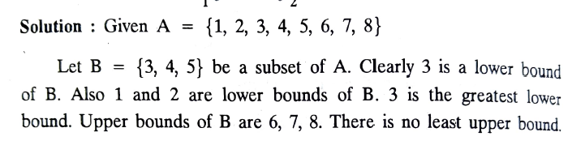
Solution

Slide 16
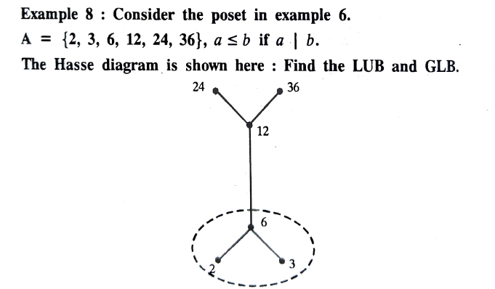
Problem 2

Slide 17
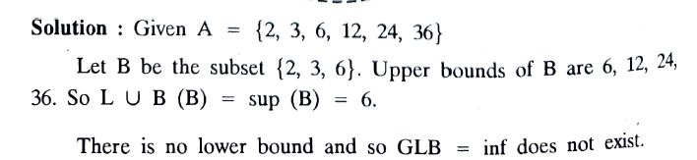
Solution

Slide 18
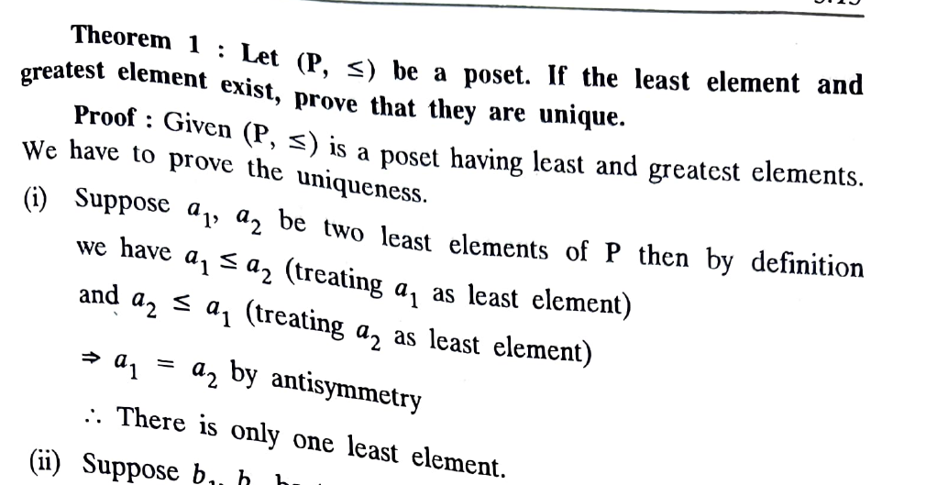
Theorem

Slide 19
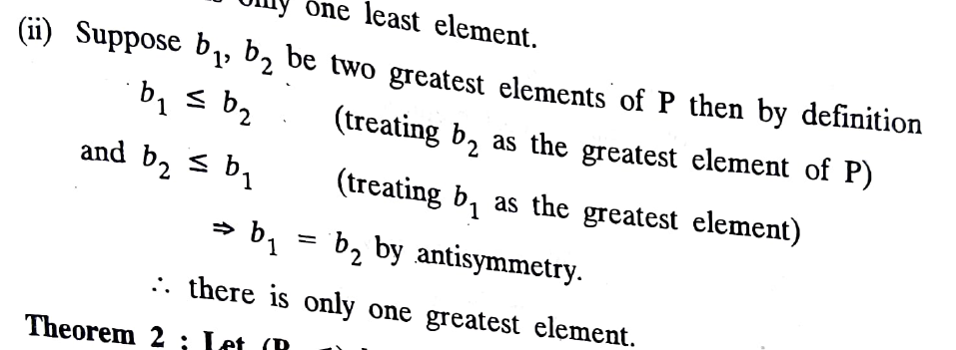

Slide 20
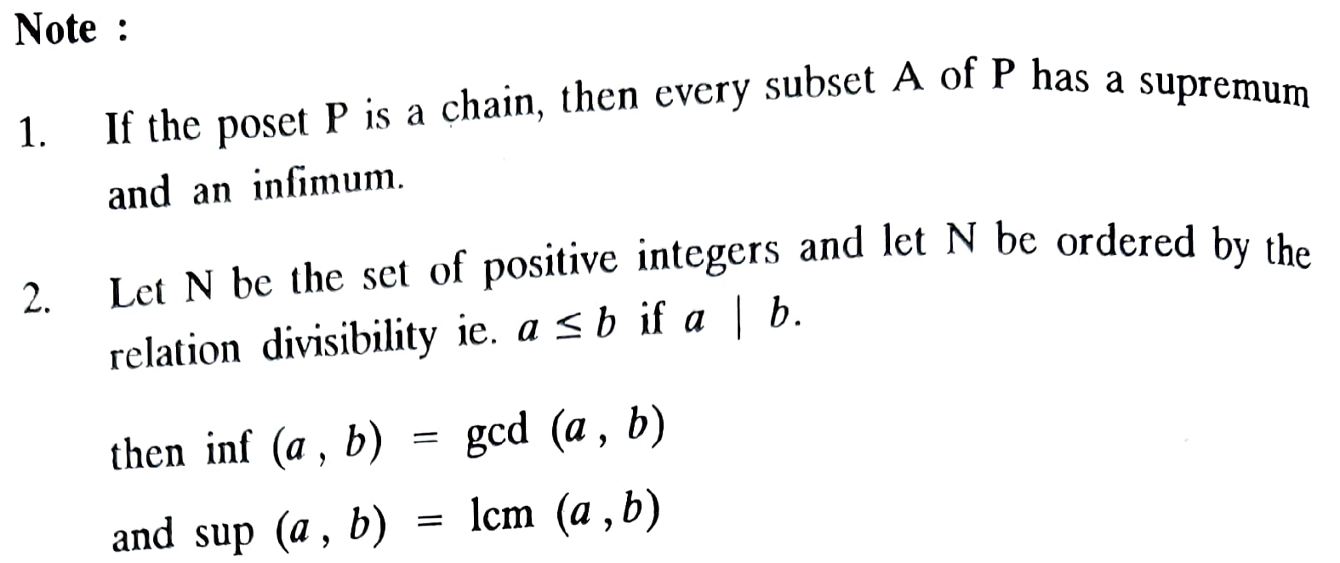
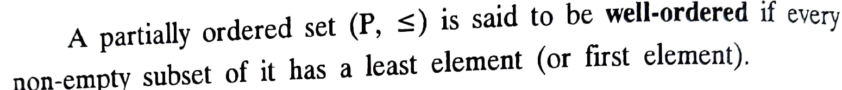
Note:

Slide 21
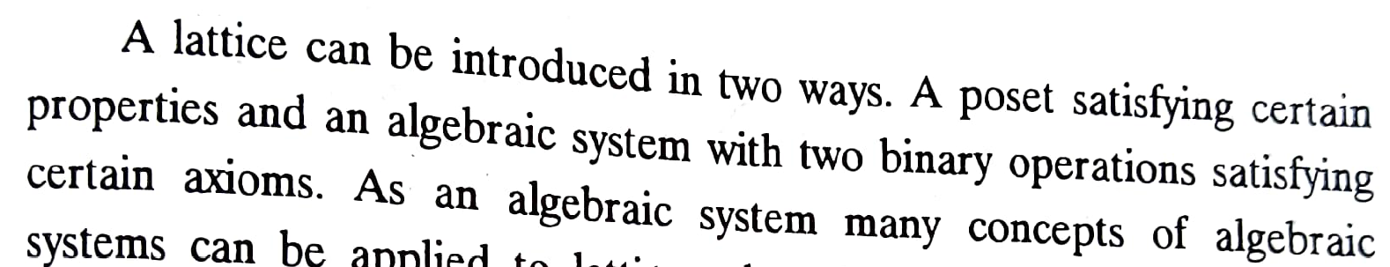
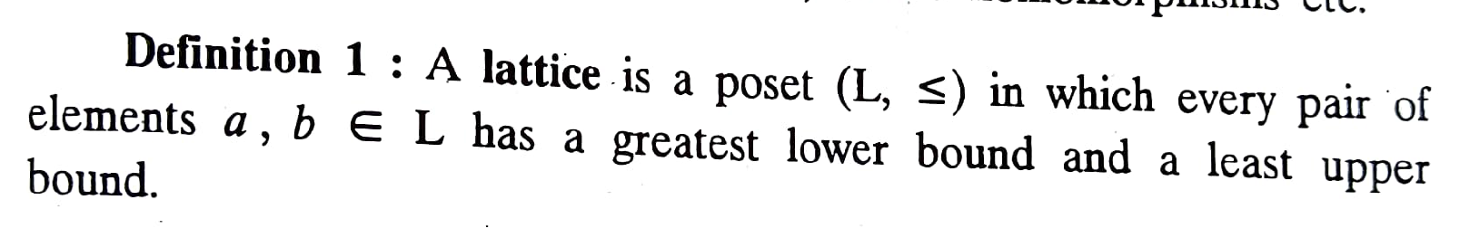
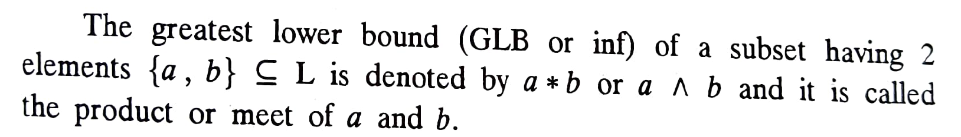
Lattices

Slide 22
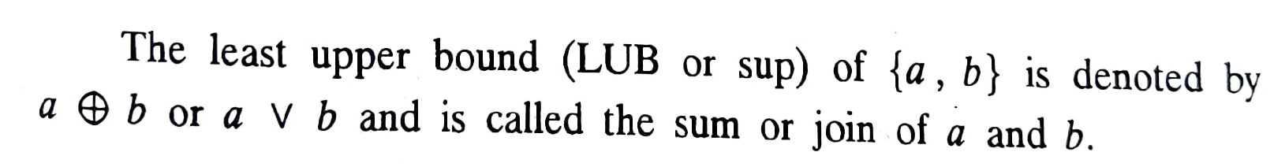
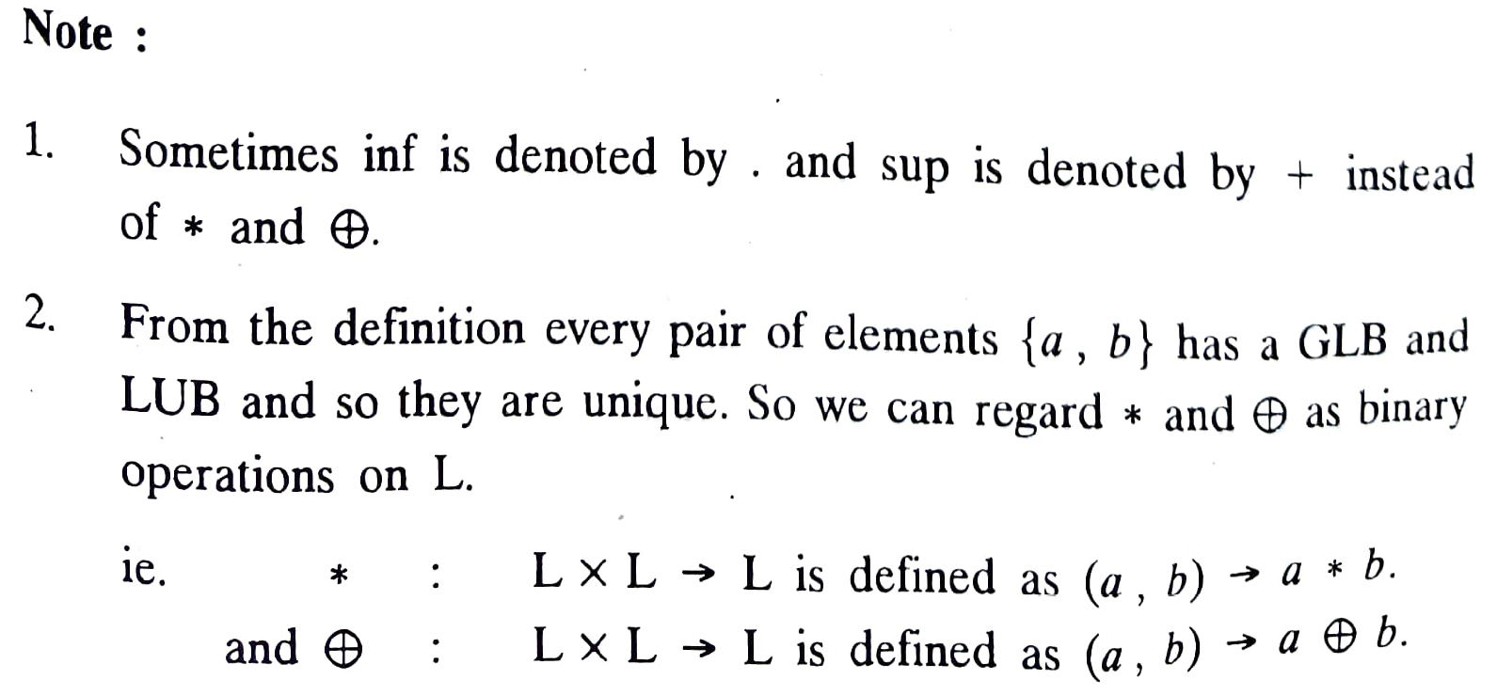
Lattices

Slide 23
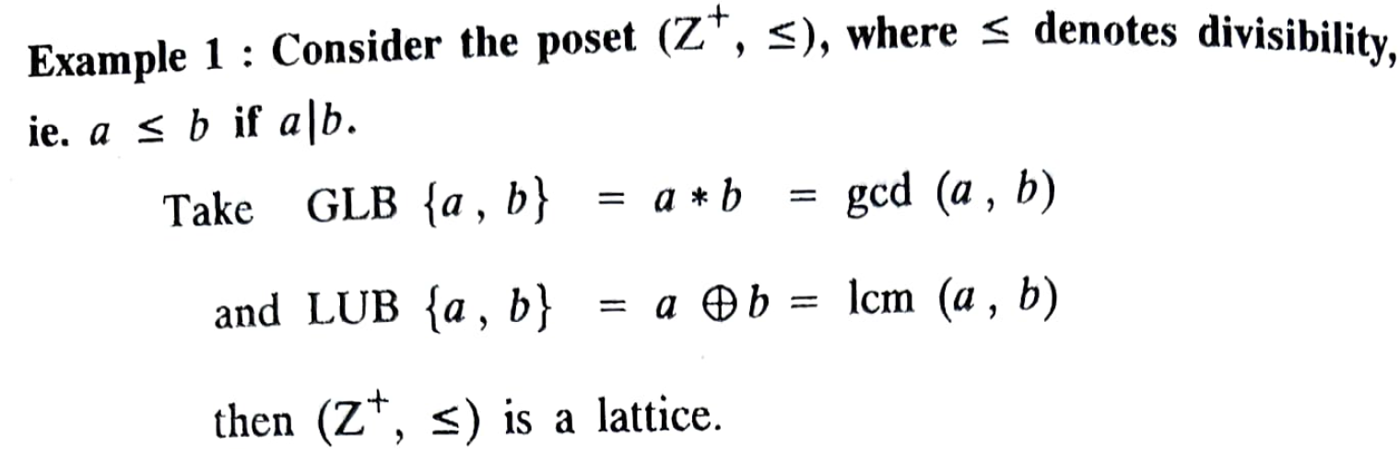
Lattices – examples

Slide 24
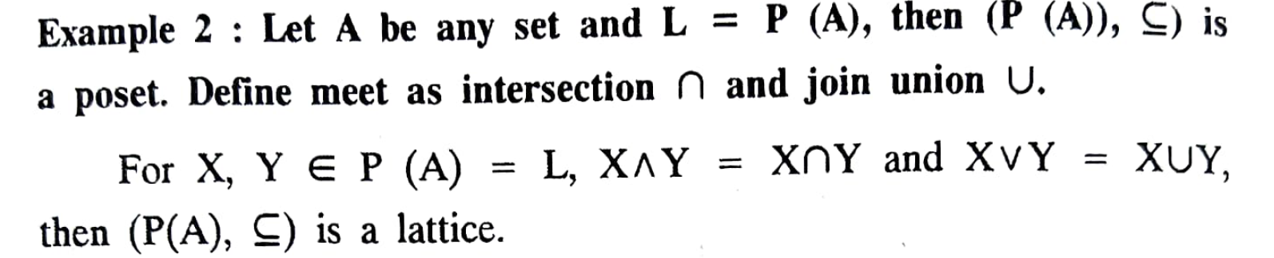
Lattices - examples

Slide 25
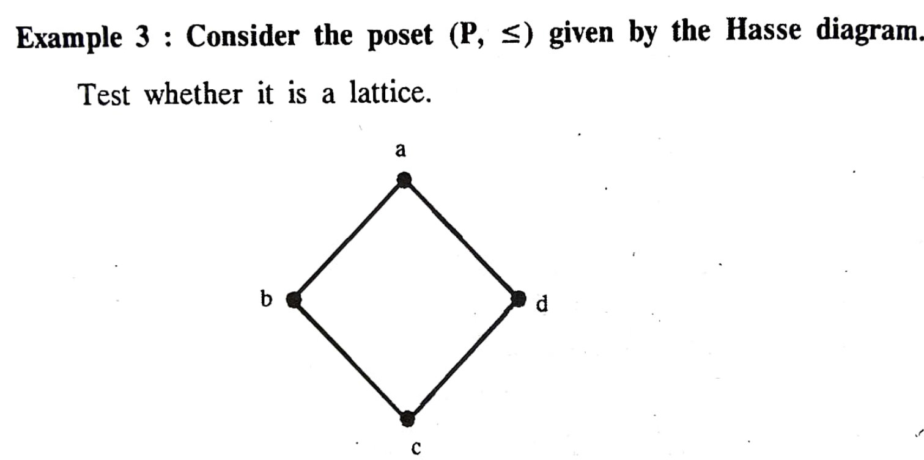
Lattices - examples

Slide 26
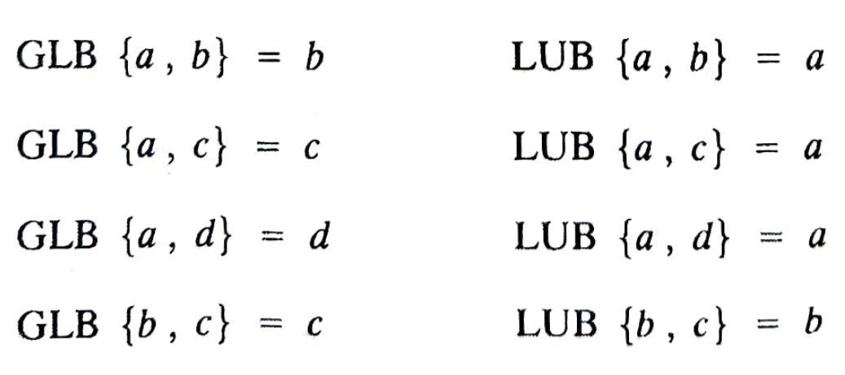
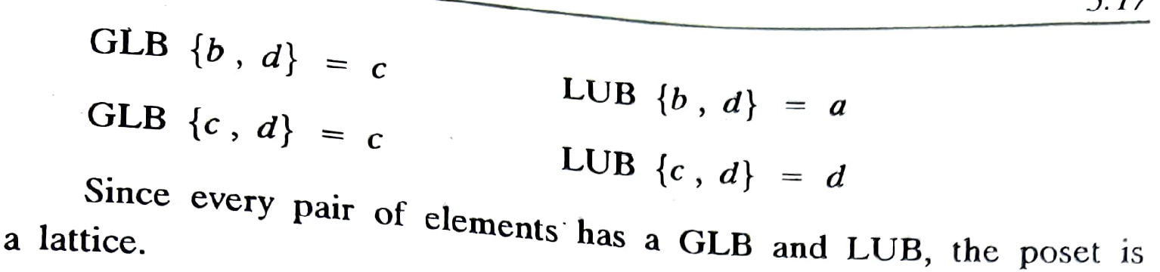
Lattices - examples

Slide 27
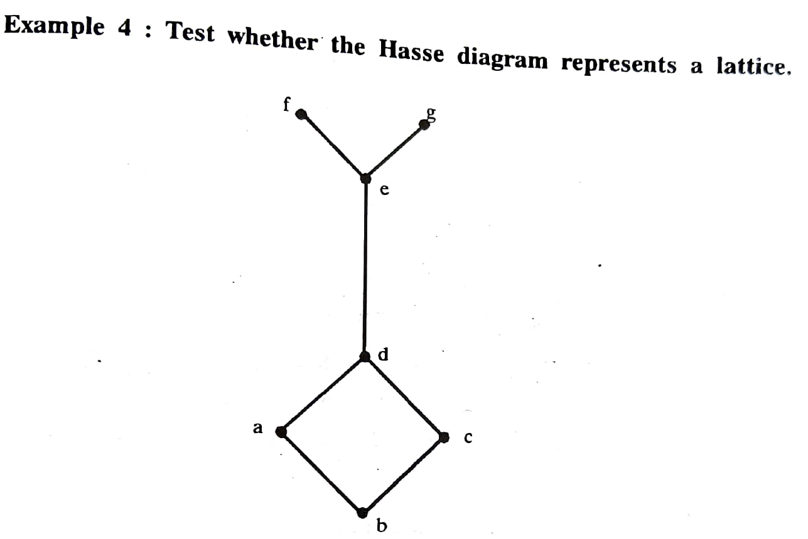
Lattices - examples

Slide 28
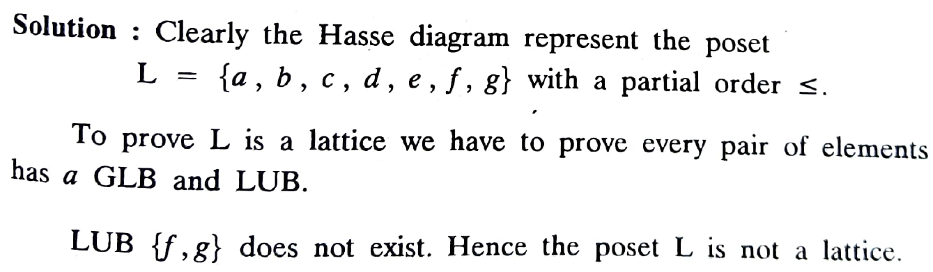
Lattices - examples

Slide 29
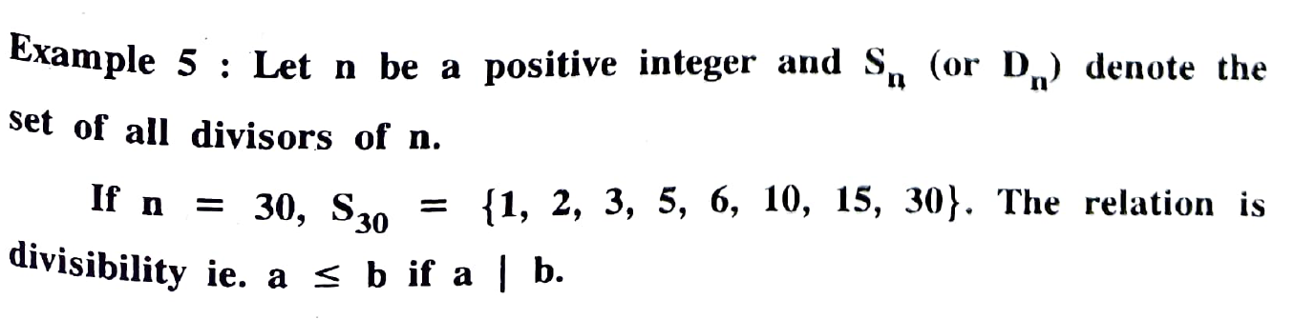
Lattices - examples

Slide 30
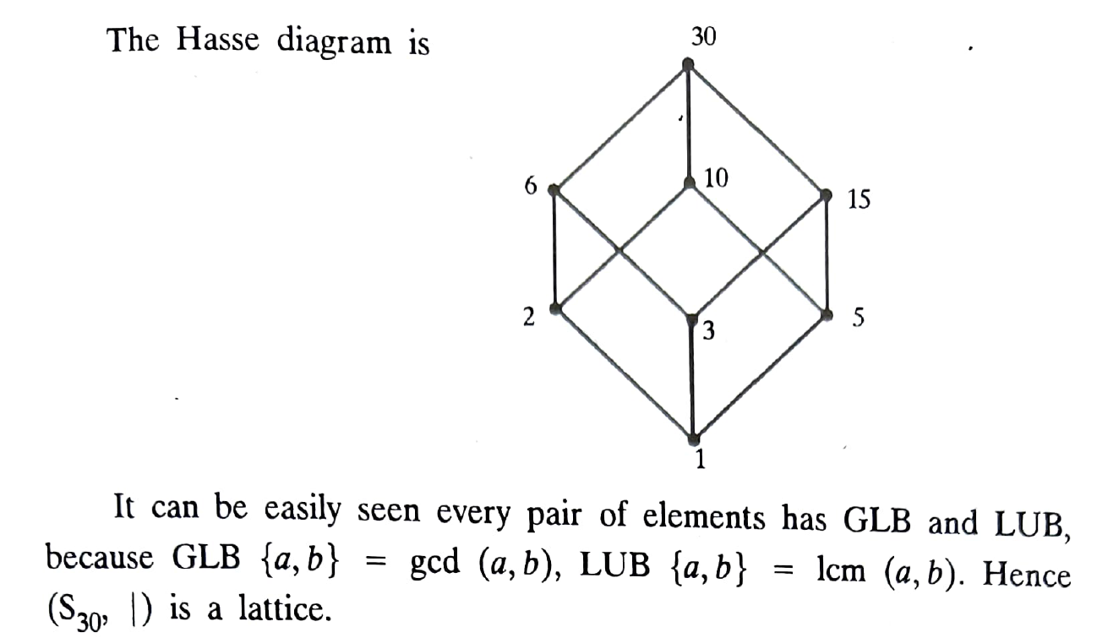
Lattices - examples

Slide 31
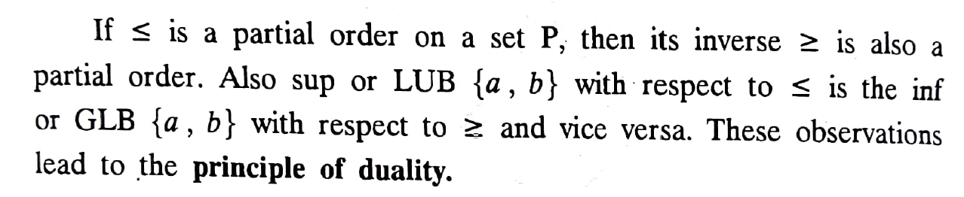
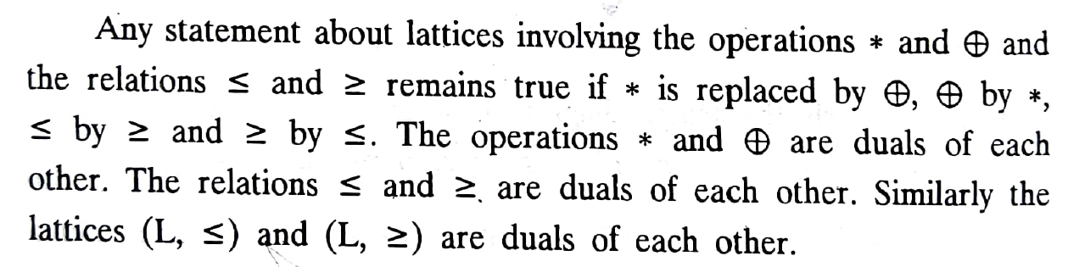
Principle of duality for lattices

Slide 32
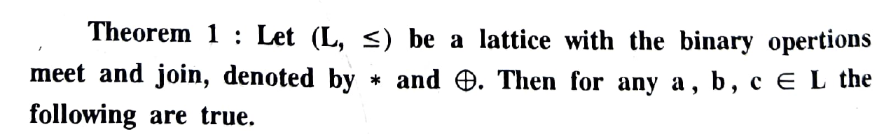
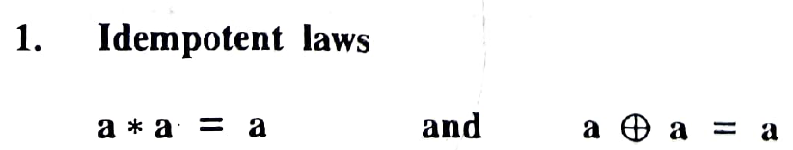
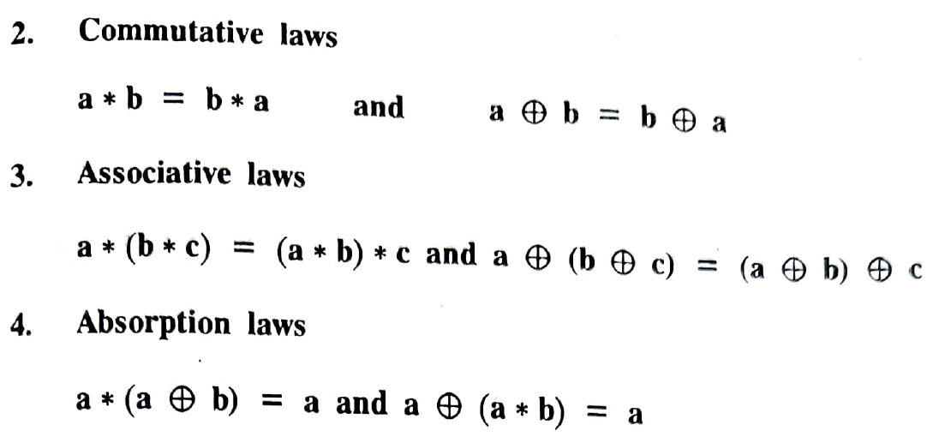
Lattices - Properties

Slide 33
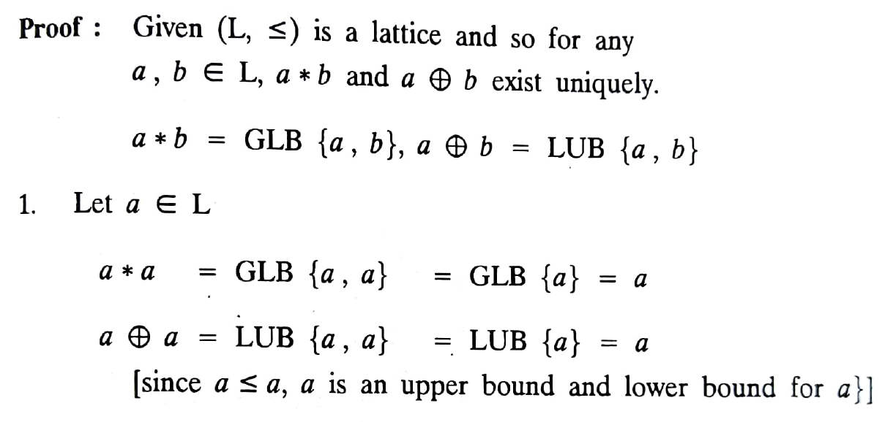
Proof:

Slide 34
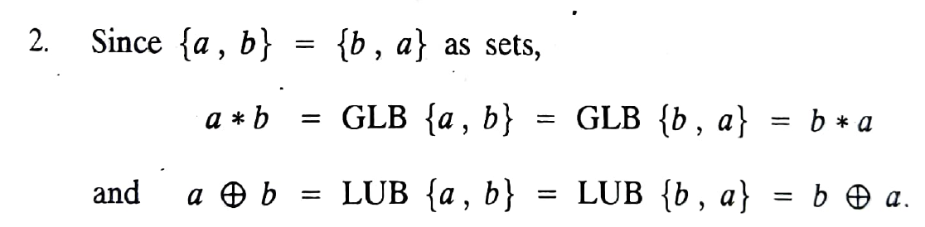
Proof:

Slide 35





Properties of Lattices
Let $\left(L, ≤\right)$ be a lattice with the binary operations meet and join. Then for any $a, b, c∈L$
$a ∧a=a$ ; $a∨a=a$
$a∧b=b∧a$; $a∨b=b∨a$
$\left(a∧b\right)∧c=a∧\left(b∧c\right)$ ; $\left(a∨b\right)∨c=a∨\left(b∨c\right)$
$a∧\left(a∨b\right)=a$ ; $a∨\left(a∧b\right)=a$
$$Idempotent laws$$
$$Commutative laws$$
$$Associate laws$$
$$Absorption laws$$

Slide 36
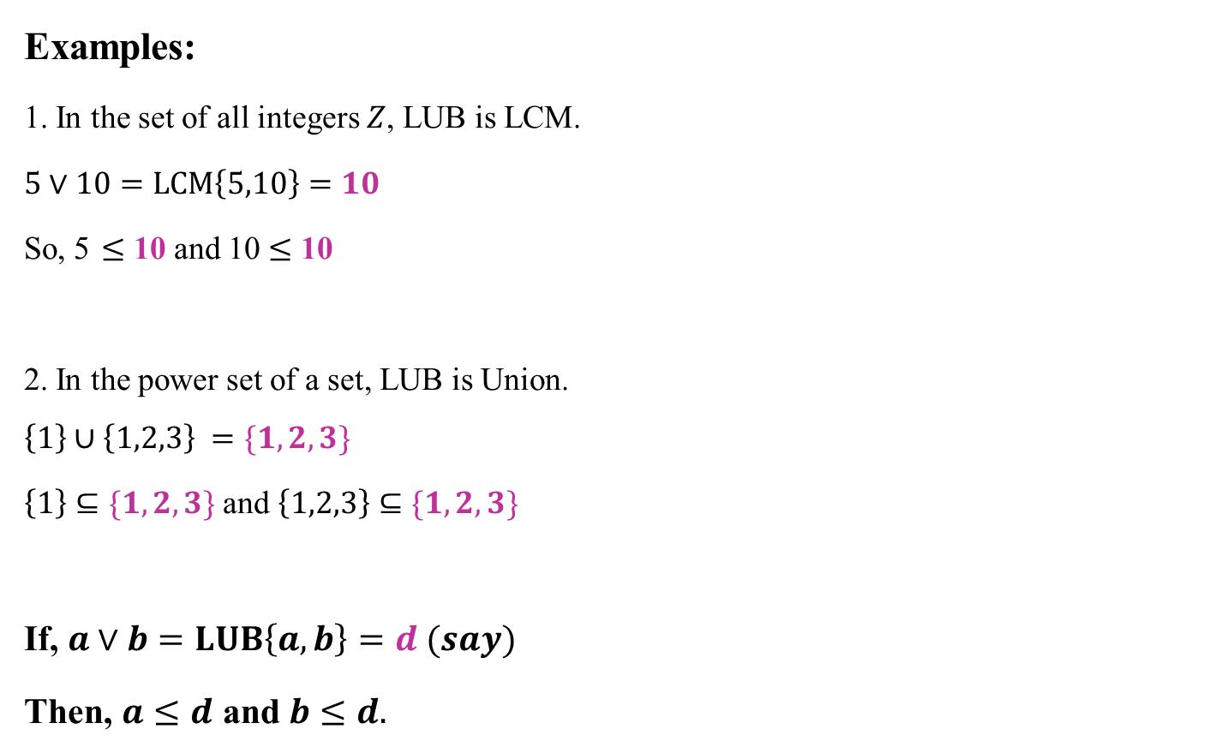
Remark
Examples:
1. In the set of all integers $Z$, LUB is LCM.
$5∨10=LCM\left\{5,10\right\}=10$
So, 5 $≤$ 10 and 10 $≤$ 10
2. In the power set of a set, LUB is Union.
$$\left\{1\right\}∪\left\{1,2,3\right\} =\{1,2,3\}$$
$\left\{1\right\}⊆\{1,2,3\}$ and $\left\{1,2,3\right\}⊆\{1,2,3\}$
If, $a∨b=LUB\left\{a,b\right\}=d (say)$
Then, $a≤d$ and $b≤d.$

Slide 37
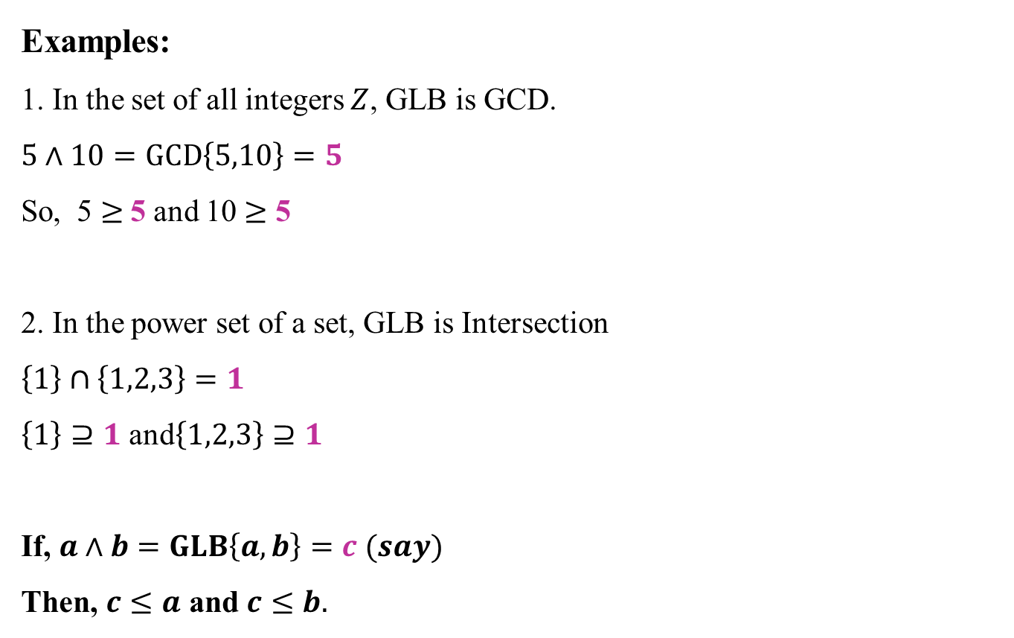
Remark
Examples:
1. In the set of all integers $Z$, GLB is GCD.
$5∧10=GCD\left\{5,10\right\}=5$
So, 5 $≥$5 and 10 $≥$ 5
2. In the power set of a set, GLB is Intersection
$$\left\{1\right\}∩\left\{1,2,3\right\}=1$$
$\left\{1\right\}⊇1$ and$\left\{1,2,3\right\}⊇1$
If, $a∧b=GLB\left\{a,b\right\}=c (say)$
Then, $c≤a$ and $c≤b.$

Slide 38

Remark
So,
$a∨b$ means
$$a≤a∨b;b≤a∨b$$
$a∧b$means
$a∧b≤a; a∧b≤b$

Slide 39
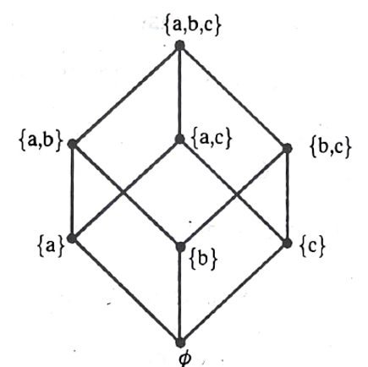

Points to remember
$If, a≤a∨b;a≤a∨c$ then $a≤\left(a∨b\right)∧(a∨c)$
Example:
Let $a=1, b=2$ and $c=3$
$$a∨b=a∪b=\left\{1,2\right\}$$
$$a∨c=a∪c=\left\{1,3\right\}$$
If, $1⊆\left\{1,2\right\};1⊆\left\{1,3\right\}$ then $1⊆\left\{1,2\right\}∩\left\{1,3\right\}=\left\{1\right\}.$

Slide 40

Points to remember
Let $a=1, b=2$ and $c=3$
$$a∧b=a∩b=\left\{φ\right\}$$
$$a∧c=a∩c=\left\{φ\right\}$$
If, $φ⊆\left\{a\right\};φ⊆\left\{a\right\}$ then $φ∪φ=φ⊆a$
$If, a∧b≤a;a∧c≤a$ then $\left(a∧b\right)∨\left(a∧c\right)≤a$

Slide 41


Associative Law
3. To prove $\left(a∧b\right)∧c=a∧\left(b∧c\right)$
Let $a, b, c∈L$
$\left(a∧b\right)∧c≤(a∧b)$-----(1)
$\left(a∧b\right)∧c≤c$ -------------------(2)

Slide 42

Associative Law
3. To prove $\left(a∧b\right)∧c=a∧\left(b∧c\right)$
Let $a, b, c∈L$
$\left(a∧b\right)∧c≤(a∧b)$-----(1)
$\left(a∧b\right)∧c≤c$ -------------------(2)
But $\left(a∧b\right)≤a$ ---(3)
$\left(a∧b\right)≤b$---(4)

Slide 43



Associative Law
3. To prove $\left(a∧b\right)∧c=a∧\left(b∧c\right)$
Let $a, b, c∈L$
$\left(a∧b\right)∧c≤(a∧b)$-----(1)
$\left(a∧b\right)∧c≤c$ -------------------(2)
But $\left(a∧b\right)≤a$ ---(3)
$\left(a∧b\right)≤b$---(4)
Therefore (1) becomes,
$\left(a∧b\right)∧c≤a$ -----------------------(4)
and $\left(a∧b\right)∧c≤b$-------------------(5)

Slide 44




Associative Law
3. To prove $\left(a∧b\right)∧c=a∧\left(b∧c\right)$
Let $a, b, c∈L$
From (2) and (5) we get $\left(a∧b\right)∧c$ is a lower bound for $b$ and $c$.
Therefore $\left(a∧b\right)∧c≤(b∧c)$-----(6)
$\left(a∧b\right)∧c≤(a∧b)$-----(1)
$\left(a∧b\right)∧c≤c$ -------------------(2)
But $\left(a∧b\right)≤a$ ---(3)
$\left(a∧b\right)≤b$---(4)
Therefore (1) becomes,
$\left(a∧b\right)∧c≤a$ -----------------------(4)
and $\left(a∧b\right)∧c≤b$-------------------(5)

Slide 45




Associative Law
3. To prove $\left(a∧b\right)∧c=a∧\left(b∧c\right)$
Let $a, b, c∈L$
From (2) and (5) we get $\left(a∧b\right)∧c$ is a lower bound for $b$ and $c$.
Therefore $\left(a∧b\right)∧c≤(b∧c)$-----(6)
$\left(a∧b\right)∧c≤(a∧b)$-----(1)
$\left(a∧b\right)∧c≤c$ -------------------(2)
But $\left(a∧b\right)≤a$ ---(3)
$\left(a∧b\right)≤b$---(4)
From (4) and (6),
$\left(a∧b\right)∧c≤a∧(b∧c)$ ------(A)
Therefore (1) becomes,
$\left(a∧b\right)∧c≤a$ -----------------------(4)
and $\left(a∧b\right)∧c≤b$-------------------(5)

Slide 46






Associative Law
3. To prove $\left(6∧9\right)∧56=6∧\left(9∧56\right)$
From (2) and (5) we get $\left(6∧9\right)∧$56 is a lower bound for $b$ and $c$.
$∴$ $\left(6∧9\right)∧56≤(9∧56)$-----(6)
$\left(6∧9\right)∧56≤(6∧9)$-----(1)
$\left(6∧9\right)∧56≤56$ -------------------(2)
But $\left(6∧9\right)≤6$ ---(3)
$\left(6∧9\right)≤9$---(4)
From (4) and (6),
$\left(6∧9\right)∧56≤6∧(9∧56)$ ---(A)
Therefore (1) becomes,
$\left(6∧9\right)∧56≤$6 -----------------------(4)
and $\left(6∧9\right)∧56≤$9-------------------(5)

Slide 47

Associative Law
Now,
$a∧\left(b∧c\right)≤a$ -----(1)
and $a∧\left(b∧c\right)≤$ $\left(b∧c\right)$ --------(2)

Slide 48

Associative Law
Now,
$a∧\left(b∧c\right)≤a$ -----(1)
and $a∧\left(b∧c\right)≤$ $\left(b∧c\right)$ --------(2)
but $\left(b∧c\right)≤b$ and $\left(b∧c\right)≤c,$ therefore, (2) becomes

Slide 49

Associative Law
Now,
$a∧\left(b∧c\right)≤a$ -----(1)
and $a∧\left(b∧c\right)≤$ $\left(b∧c\right)$ --------(2)
but $\left(b∧c\right)≤b$ and $\left(b∧c\right)≤c,$ therefore, (2) becomes
$a∧\left(b∧c\right)≤b$ ---------------------------------(3)
$a∧\left(b∧c\right)≤c$ ---------------------------------(4)

Slide 50




Associative Law
Now,
$a∧\left(b∧c\right)≤a$ -----(1)
and $a∧\left(b∧c\right)≤$ $\left(b∧c\right)$ --------(2)
but $\left(b∧c\right)≤b$ and $\left(b∧c\right)≤c,$ therefore, (2) becomes
$a∧\left(b∧c\right)≤b$ ---------------------------------(3)
$a∧\left(b∧c\right)≤c$ ---------------------------------(4)
From (1) and (3) $a∧\left(b∧c\right)≤$ $a∧b$----------(5)

Slide 51





Associative Law
Now,
$a∧\left(b∧c\right)≤a$ -----(1)
and $a∧\left(b∧c\right)≤$ $\left(b∧c\right)$ --------(2)
but $\left(b∧c\right)≤b$ and $\left(b∧c\right)≤c,$ therefore, (2) becomes
$a∧\left(b∧c\right)≤b$ ---------------------------------(3)
$a∧\left(b∧c\right)≤c$ ---------------------------------(4)
From (1) and (3) $a∧\left(b∧c\right)≤$ $a∧b$----------(5)
From (4) and (5), $a∧\left(b∧c\right)≤\left(a∧b\right)∧c$-----(B)

Slide 52





Associative Law
Now,
$a∧\left(b∧c\right)≤a$ -----(1)
and $a∧\left(b∧c\right)≤$ $\left(b∧c\right)$ --------(2)
but $\left(b∧c\right)≤b$ and $\left(b∧c\right)≤c,$ therefore, (2) becomes
$a∧\left(b∧c\right)≤b$ ---------------------------------(3)
$a∧\left(b∧c\right)≤c$ ---------------------------------(4)
From (1) and (3) $a∧\left(b∧c\right)≤$ $\left(a∧b\right)$----------(5)
From (4) and (5), $a∧\left(b∧c\right)≤\left(a∧b\right)∧c$-----(B)
From (A) and (B), $a∧\left(b∧c\right)=\left(a∧b\right)∧c$

Slide 53


Associative Law
Now,
$a∧\left(b∧c\right)≤a$ -----(1)
and $a∧\left(b∧c\right)≤$ $\left(b∧c\right)$ --------(2)
but $\left(b∧c\right)≤b$ and $\left(b∧c\right)≤c,$ therefore, (2) becomes
$a∧\left(b∧c\right)≤b$ ---------------------------------(3)
$a∧\left(b∧c\right)≤c$ ---------------------------------(4)
From (1) and (3) $a∧\left(b∧c\right)≤$ $\left(a∧b\right)$----------(5)
From (4) and (5), $a∧\left(b∧c\right)≤\left(a∧b\right)∧c$-----(B)
From (A) and (B), $a∧\left(b∧c\right)=\left(a∧b\right)∧c$
similarly, we can prove$a∨\left(b∨c\right)=\left(a∨b\right)∨c$

Slide 54


Properties of Lattices
$$Absorption laws$$
$a∧\left(a∨b\right)=a$ ; $a∨\left(a∧b\right)=a$
Let $a, b∈L$
we have $a≤a$ and $a≤a∨b$
Therefore $a≤a∧(a∨b)$
On the other hand, $a∧\left(a∨b\right)≤a$
which implies $a∧\left(a∨b\right)=a$
Similarly, we can prove $a∨\left(a∧b\right)=a$.

Slide 55

Properties of Lattices
$$Absorption laws$$
To prove $a∨\left(a∧b\right)=a$
Let $a, b∈L$
we have $a≤a$ and $a∧b≤a$
Therefore $a∨(a∧b)≤a$
On the other hand, $a≤a∨(a∧b)$
which implies $a∨(a∧b)=a$

